Slide 1
Show me the…
Money and Banking

Slide 2
What is “money”?
Any universally accepted medium of exchange between buyers and sellers for goods and services in an economy
Difference between money and wealth:
Money is used in exchange
Wealth is the value of assets held by an individual, firm or government

Slide 3
4 Properties of Money :
1. Unit of Exchange
Accepted as payment in the market
Used to use barter system of exchanging goods
Problem if milk is not what the butcher wants, but the dairy owner wants meat and the butcher wants eggs…
Shortens and reduces cost of potential transaction chain

Slide 4
Properties of money continued
2. Unit of Accounting
Pricing system
Vehicle to compare goods and services
Standard of value
Way to measure income, profit, loss, budget and expenses

Slide 5
Properties of Money continued
3. Store of Value
Purchasing power
Way to transfer wealth
4. Standard of deferred payment
Method of debt repayment

Slide 6
Money as an asset
Liquid: easily acquired and disposed of (cash is most liquid, collectibles would be among the least)
Low transaction costs
Certainty (relative) of value
A price to the liquidity in the form of less potential (interest) earnings if invested in another (riskier) financial product

Slide 7
History of Money
1. Barter: direct exchange of goods and services
2. Commodity: goods (gold, silver, cloth…) used to trade for goods
Initially paper money just represented gold or silver
“gold standard” (commodity-backed money)
Amount of money in circulation was backed by an equivalent amount of value in gold
If you had $1 you could exchange it for $1 in gold
Limitations:
Finite/availability of gold
Today, credit/internet transactions
Practicality

Slide 8
Money today
Fiat Money:
Government declares the legal value of currency (printed paper and coin)
No commodity backing
Fiduciary Monetary System: “trust” in Latin
Problems
Inflation
Confidence
“predicted” value

Slide 9
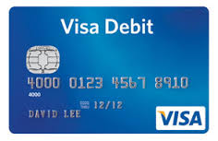
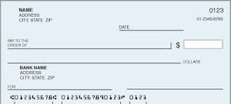
Foundation of Fiduciary Monetary System
Transaction Deposits
Debits and Deposit accounts (checking accounts)
Easily accessed
Banks and Credit Unions

Slide 10
Assumptions of our banking system
1. Acceptability
is what makes money, money
sellers, buyers, creditors and debtors all accept it as a form of exchange
2. Predictability
value even during inflation
confidence in value (so continue to use even knowing it will be devalued over time)

Slide 11
Measuring money
Money supply: the amount of money in circulation (in the hands of the public)

Slide 12
Measuring Money: M1 and M2
M1: transaction approach
M2: liquidity approach
Money as a medium of exchange
Currency
Paper or coins printed under U.S. Treasury
Transaction Deposits
Depository institutions’
Commercial banks, thrifts (savings banks; savings and loans), credit unions
Checking accounts: debit card/check transaction accounts
Money as a temporary store of value
M1 + savings deposits (no maturity time) + small (<$100k) timed deposits (penalty for withdrawing early: Certificate of Deposit) + money market mutual funds (bank held and FDIC insured)

Slide 13
Measuring Money continued
MZM = money at zero maturity money stock
M1 + savings deposits + money market funds
No maturity date accounts (CDs)

Slide 14
Step back: Securities overview
Historical
Dutch East India Company in 1602
1. Stocks: Raised capital by selling shares of company based on expected FUTURE profits
Shareholders receive a stock or a piece of ownership in the company
Received a dividend based on the amount of stock they purchased (the percentage of ownership)
2. Bonds: Took out loans in return for FUTURE interest and repayment: bonds
Over time they paid off the loans
Profits were paid out after the loans to the shareholders

Slide 15
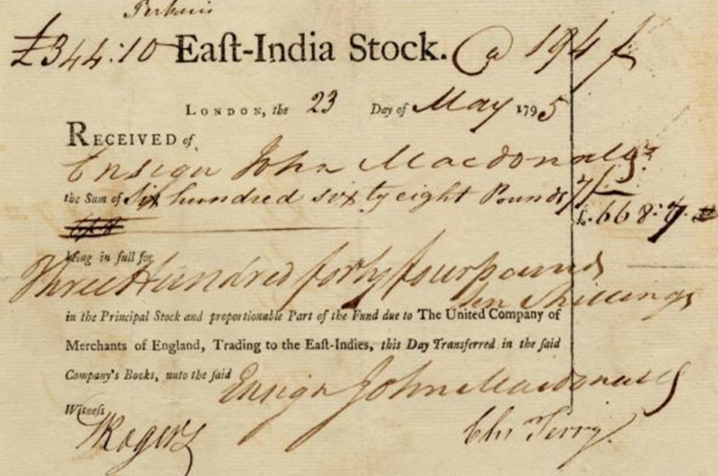
Stocks
Share:
Legal claim to future profits
Common stock = voting rights (with board)
Vote in proportion to the amount of stock owned
Preferred stock = no voting rights
Certain amount of dividends paid out when common stock holders may not receive as much or any (preferred paid first)

Slide 16
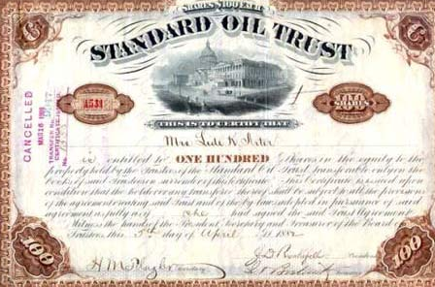
Bonds: Direct Loan
Legal claim against a firm
Owner receives fixed coupon payment + lump sum at maturity date
Issued in return for money lent to a company
Not a piece of ownership in the company
Not claims on future profits (dividends)
Bond holder receive the amount on the issued bond regardless of the company’s profits
Typically get coupon payment annually
Paid before shareholders dividends

Slide 17
Banking system: 2 institutions
1. Privately owned
For profit
Commercial banks, thrifts
2. Central bank
Banker’s bank
Bank of government
Regulate commercial banks

Slide 18
Financing
1. Direct – individual holds bonds
2. Indirect – bank
Banks transfer money from savers to investors
“financial intermediaries”

Slide 19
Why use a bank?
Risk of direct lending
Asymmetric information
The company knows more about how they are doing than you do
Moral hazards mean that executives may take greater risks than were originally told to investors once they have the funds
Bank offers a way of diluting some risk
Investigate likelihood of loan repayment
Monitor the loan
Pool funds of other savers: increased size of savings = less costs = less risk

Slide 20
How does banking work?
Banks hold deposits which they in turn lend out
These are bank “liabilities”
They have to be able to “pay back” your deposit if you want to withdraw the funds
They lend the money for different things
Different size financials lend for different things
Large commercial banks: commercial (business) loans, mortgages
Small banks and credit unions: personal loans (but today they do the big loans, too depending on licensing)

Slide 21
Financial Intermediation Process
Ultimate lenders: households, businesses, governments
Financial intermediaries: Commercial banks, S&Ls, savings banks, CUs, Insurance co., Mutual funds, pension funds, govts
Ultimate Borrowers: Households, businesses governments

Slide 22
Federal Reserve
When you use a check or electronic payment, the central bank is the intermediary between money on deposit from one bank to a payment to another
Central bank of the U.S.
President Wilson 1913: Federal Reserve Act

Slide 23
Structure of the Fed
Board of Governors:
7 FT members appointed by the U.S. President and approved by Senate
14 year terms
can’t be removed for policy
Chairman (chair-woman today!) of the Board
4 yr terms, appointed (from Board) by President
Goes before Congress
Ben Bernanke since 2006; Janet Yellen (2/2014)

Slide 24
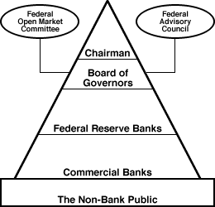
Federal Reserve Structure

Slide 25
Structure of Fed continued
12 Districts
25 Branches
Depository institutions: all financial institutions that accept deposits
Federal Open Market Committee (Yellen is also the head of)
Deals with monetary policy making and determining the money supply
Part of the monetary system
Federal monitors
Requires financials to keep a certain % of funds on reserve in the vault and assigned Federal Reserve District Bank (amount depends on bank’s transaction volume)

Slide 26
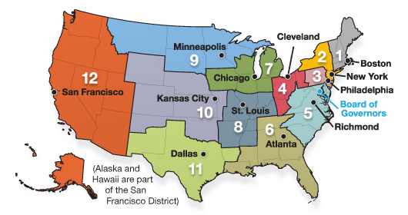
Federal Reserve Districts

Slide 27
What does the Federal Reserve do?
1. Supplies economy with currency
Paper money = Federal Reserve Notes
Each $ has a code for the Federal Reserve Bank who 1st puts it into circulation
Each note is a liability of the Federal Reserve System, NOT the U.S. Treasury
2. Fed holds financials’ reserves and is a payment clearing system
Financials have to keep a % of transaction deposits on reserve
Can access as needed
Clearing house for payments from 1 financial to another
Checks and electronic clearing payments

Slide 28
Balance Sheet example: assets have to equal liabilities
Assets | Liabilities
Reserves $100,000 | Transactions Deposits $1,000,000
Loans $900,000
TOTAL $1,000,000 | TOTAL $1,000,000

Slide 29
Sample problem of money supply and banking together: Government of Macroland measures their money supply like the U.S. Their central bank has a required reserve ratio of 15%.
Bank deposits at central bank: $300m Currency held by public: $200m
Currency held in bank vaults: $150m Travelers checks (M1) = $5m
Checkable bank deposits (M1 money) = $650m
1. M1 = sum of currency held by public + checkable deposits + travelers checks
M1 = 200m + 650m + 5m = 855m
2. monetary base = sum of currency held by public + bank vaults + dep at central bank
Monetary base = 200 + 150 + 300 = 650m
3. Required reserves = req res ratio x checkable deposits = .15 X 650m = 97.5m
4. Excess reserves = total reserves – required reserves = 450m – 97.5 = 352.5m
Total reserves = deposits at central bank and bank vault deposits = 300 + 150 = 450m
5. Can the bank increase checkable deposits (for potential loans)? Yes:
Excess reserves = $352.5m X res ratio of 15% = $52.88m req reserves, so 352.5 – 52.88 = $299.62 avail for more checkable deposits (and there will be enough in require reserves to cover the deposit liability)

Slide 30
If bank has excess reserves, they can take more deposits and then turn around and make more loans

Slide 31
Fed’s job continued
3. Fiscal agent
U.S. Treasury has an account
Helps with tax revenue
Purchase and sale of government securities
4. Works with FDIC, Comptroller of currency, Office of Thrift Supervision and NCUA to regulate financials
5. Conducts monetary policy
Money supply

Slide 32
Fed’s job continued
6. Foreign Currency Markets
Buys/sells foreign currency to adjust the value of the $
7. “lender of last resort”
If a bank is low on cash temporarily, the Fed will provide funds to prevent illiquidity
Key word is temporary
Funds paid out rose rapidly in past decade

Slide 33
Fractional Reserve Banking
Depository institution holds less in reserves than total deposited
Banks don’t keep 100% of deposits on hand
Reserves kept in own cash vault and Federal Reserve Bank
Reserve Ratio
Fed “required reserves”
“excess reserves” that bank wishes to have
i.e. Bank has deposits of 1,000,000 at 10% Federal Reserve Ratio = $100,000 on reserve

Slide 34
Monetary Policy and Fractional Reserve Banking
Fed can increase the quantity of money with the banking system
Open market operation = Fed purchases and sells U.S. government securities (bonds) in private secondary market (bond dealer, investment banker)
i.e. Fed buys $100k bond from a broker
Fed transfers $100k to bond dealer’s account at Bank A. Bank A’s deposit liabilities go up by $100k (new money from the Fed into the system). If the Fed Reserve deposit ratio is 10% so with + $100k, $10k more to reserves
$90k goes to new loans for Bank A
Cycle continues: recipient of $90k spends $ which will be deposited at other banks
New bank has 10% reserve requirement, so $9k goes in reserve and they have $81k to lend
Opposite if Fed sells government bonds

Slide 35
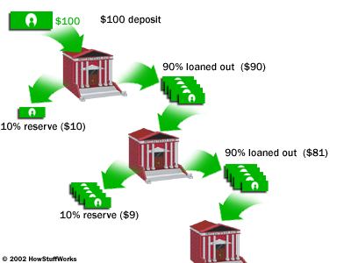

Slide 36
Bank | New Deposits | New Reserves (10%) | Maximum New Loans
1 | $100,000 (from Fed) | $10,000 | $90,000
2 | $90,000 | $9,000 | $81,000
3 | $81,000 | $8,100 | $72,900
4 | $72,900 | $7,290 | $65,610
Etc.
All other banks | $656,100 | $65,610 | $590,490
Totals | $1,000,000 | $100,000 | $900,000

Slide 37
Money multiplier
Measures the total amount that the money supply changes if bank reserves go up or down
# multiplied by change in reserves = change in $ supply
Potential money multiplier = 1/reserve ratio
(1/fraction of deposits bank hold on reserve)
Problem: Cash Leakage when borrowers hold some funds outside of the banking system
So money is not on reserve to make more loans
More leakage = smaller actual money multiplier
Real world: potential money multiplier usually higher than actual b/c of leakage and depends on the definition of money supply (M1, M2, MZM)

Slide 38
Money Multiplier Example
Fed injects $100,000
At reserve ration of 10%
1/.1 = 10
10 X $100,000 = 1,000,000

Slide 39
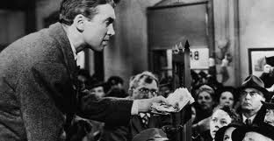
Federal Deposit Insurance Corporation: FDIC
Because banks only hold a % of deposits on hand
Risk of bank run: all depositors want their funds at the same time
Causes bank failures
1929- 1933: average of 3k banks failed/year
1933 Federal Deposit Insurance Corporation formed
Funds depositors
Increased confidence in banks
Higher amount of deposits (both # and $ of)
$250k per person per institution
Credit unions added in 1971

Slide 40
FDIC flaws
Premiums
Same for all institutions regardless of size and risk
Bank managers are more willing to take risks because the fee doesn’t rise with the risk and their deposits are protected
Premium too small
People are willing to take lower deposit % rate for the security of the insurance
Abused for profit by bankers
Lack of monitoring
Depositors feel protected so they aren’t paying close attention to risks taken by management
Moral hazards of managers

Slide 41
FDIC reforms
Regulations to try to fix some of the issues with enforcement in the early 2000s
Higher rate of examinations (audits)
Federal Department of Insurance Reform Act of 2005
Coverage was increased
Able to adjust premiums
Premiums went up
Push back –
lower returns for banks because the premiums have gone up so some banks are actually discouraging small deposits (fees)
Low lending rates = low returns, too

Slide 42
Burt Bucks

