Slide 1
Round and Round…
The Business Cycle

Slide 2
Roller Coaster

Slide 3
KEY TERMS:
Business Cycle Components:
Expansion
Prosperity
Contraction (shrinkage)
Recession
Depression
Trough
Peak
GDP and GNP
Inflation, Deflation, Stagflation
Unemployment
CPI
Contract
Recede
Depress
Expand
Prosper

Slide 4
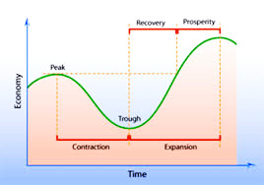
What is the Business Cycle??

Slide 5
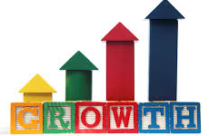
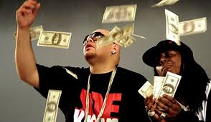
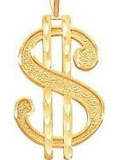
The Highs…
Expansion
Prosperity
Make it Rain

Slide 6
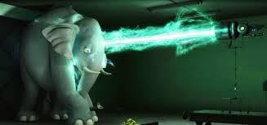
And the Lows…
Contraction
Recession
Depression

Slide 7
Historical perspective: Business Activity 1914 to 1992

Slide 8
More current data of GDP (1970-2010)

Slide 9
But what does it all mean??
Decline in production
Rise in unemploy-ment
Less spending
Contraction leads to
Recession

Slide 10
See a pattern here? Unemployment goes up when GNP/GDP goes down

Slide 11
Inflation plays a part

Slide 12
It’s not all doom and gloom
Lower rates
Increased spending
Increased production
Increased employment

