Slide 1
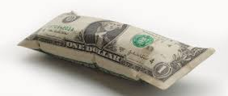
Inflation Part 2 and Unemployment

Slide 2
Inflation terms revisited:
Inflation: Dollar is losing value
Deflation: Dollar is gaining value
Disinflation: Slowing of the rate the dollar is losing value
Hyperinflation: Inflation out of control
Stagflation: Stagnation + Inflation = sitting at high inflation and unemployment

Slide 3
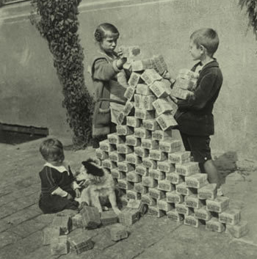
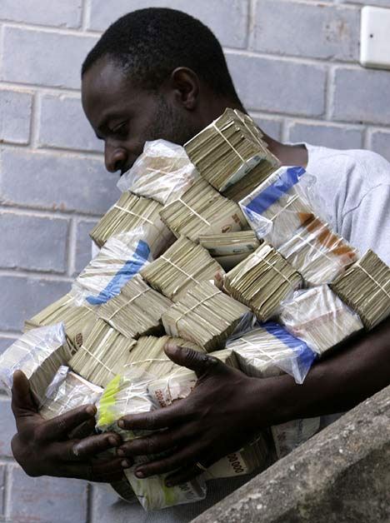
Hyperinflation

Slide 4
Germany and Hyperinflation (P = 100 in 1913
Date | Value of Price Index
Jan 1921 | 1400
Jan 1922 | 3700
Jan 1923 | 278,500
Aug 1923 | 94,400,000
Sept 1923 (state of emergency declared) | 2,390,000,000
Oct 1923 (failed Nazi coup 11/9/23) | 709,600,000,000
Nov 15, 1923 (converted to new denomination) | 75,000,000,000,000

Slide 5
Anticipated Inflation
Anticipated: Expected; consumers and businesses plan for it
COLAS (cost of living adjustments)
Bank rates adjust for
Asset allocation

Slide 6
Indexes
CPI= Consumer Price Index
Based on basket of goods from 1983 (between ‘82-’83)
GDP Deflator
Based on general price index
= current basket of goods current price/current basket of goods at real price X 100
PPI= Producer Price Index
Based on change in selling prices received by producers

Slide 7
Indexes continued
PCE= Personal Consumption Expenditure
Based on Consumer piece of the GDP

Slide 8
Unexpected Inflation Causes: Push
Causes are up for debate
Cost-Push: cost of inputs are driving up prices (labor & resources)
Wages are exceeding productivity (unions) – can be a push or a pull
Administered Prices (i.e. oil)
Market Structure (firms producing homogeneous goods)
Invisible Handshake (cultural/historical influences)
3rd Party Payment Systems (web-based system of linking buyers and seller; additional costs)
Trade Restrictions (that protect U.S. workers)

Slide 9
Unexpected Inflation Causes: Pull
Demand-Pull: too much money chasing after too few goods and services
Government Deficit Spending (spending more than collecting)
Transfer Payments (adjust to rise with inflation, but may be outpacing the actual inflation rate)
Automatic Stabilizers (i.e. unemployment insurance designed to increase spending but can increase deficits)
Politics

Slide 11
Unanticipated Winners
Incomes rise faster than inflation
Debtors (pay their debt in reduced value dollars)
Hard assets
Exporters

Slide 12
Unanticipated Losers
Fixed incomes
Creditors – loan payments are worth less because of devalued $
Importers
Consumers spend time shopping
Producers spend more time shopping for better prices on intermediate and raw materials (“shoe leather costs”)
Producers have higher labor costs to deal with shopping/pricing
Wealth Management becomes more time consuming because spend time shopping deposit rates and keeping less cash on hand

Slide 14
Sample problems: calculate Real Interest Rate
End of Year | CPI | Nominal Interest Rate | Real Interest Rate
1 | 100
2 | 110 | 15%
3 | 120 | 13%
4 | 115 | 8%

Slide 15
Labor and Unemployment
Working Age Population:
16 or older
Not in military
Not institutionalized
Disabled, NOT institutionalized
Labor Force = all who are employed and unemployed
Labor Force Participation Rate: Labor Force/Working Age Pop X 100
Employment-Population Ratio = Total Employed/Total Population

Slide 16
Unemployment
Unemployment Rate = unemployed/labor force population X 100
Unemployed: will and able to work, but have not worked 1 hour + in previous week
BLS conducts weekly survey of 60,000 people (representative of the makeup of the total population)
Have looked for work in the past 4 weeks
Temporary laid off, anticipating returning and no searching
Vacation, leave of absence = NOT unemployed

Slide 17
Unemployment continued
Not in labor force: If have not worked for pay for 1 hour or more in the previous week and have not looked for week in the past 4 weeks

Slide 18
Types of unemployment
Frictional: firm/employee mismatch; new to labor force or between jobs
Structural: Skills are mismatched for position; downsized or pushed out due to technological advances
Cyclical: Downturns in the business cycle
Seasonal: changes in employment due to the time of year

Slide 19
Who is not counted as “unemployed”?
Discouraged: willing and able, but have given up out of frustration
No effort in past 4 weeks
Marginally attached: just gave up, no effort in past 4 weeks; discouraged workers fall under this category
August 2011 – 2.6m considered “marginally attached”

Slide 20
Other problems with unemployment measurements
Dishonest workers: claiming unemployed, but working for cash under the table
Involuntary part-time workers:
work over 1 hour/week
want fulltime employment
Considered partially employed and partially unemployed

Slide 21
* Source: BLS

Slide 22
Costs of unemployment: Economic
Economic:
Opportunity cost
Output goes down
Costs go up
Consumption goes down
Okun’s Law
For every 1% increase in unemployment = 2-3% decrease in output

Slide 23
Costs of Unemployment: beyond monetary
Broader impact:
Psychological and physical impacts
Higher rates of suicide
Higher rates of crime
Higher rates of substance abuse
Higher rates of domestic violence
Higher rates of depression
Discrimination
Impacts minorities, youth, uneducated and women higher than white, educated (HS or higher) men.

Slide 24
Unemployment disparity
 | August 2007 (full employment) | August 2011 (severe slump)
Overall | 4.6% | 9.1%
Whites | 4.2 | 8.0
Hispanics | 5.5 | 11.3
Blacks | 7.7 | 16.7

Slide 25
Sample problem: Freedonia uses the same method to calculate unemployment as the BLS. Compute their unemployment rate below.
Population | 60,000
Under 16 | 9000
Over 16
In military service | 600
In hospitals | 60
In prison | 200
Worked 1 hr or more in previous week | 46,000
Searched for work in previous 4 weeks | 2140
Did not work in previous week, but would like a job if offered | 200

Slide 26
A. How large is Freedonia’s labor force?
B. How many discouraged workers live in Freedonia?
C. How are missing citizens (not all are accounted for in the chart) classified? What might they be doing?
D. How many of Freedonia’s citizens are not in the labor force?

Slide 27
What is full-employment?
Natural rate of unemployment is about 5% in the U.S. in a normally functioning economy
Frictional + structural employment = natural rate of employment
Full employment is ≠ 100%
Level of employment corresponds with natural rate
Excludes cyclical unemployment

Slide 28
Some is okay
Some unemployment is alright
Frictional unemployment: moving to better jobs; better “fits”

Slide 29
Calculate Wages with inflation
Real Wage = Nominal Wage in that Year/CPI in that year X 100
Real earnings in 1980: $269/week / CPI of 86.3 X 100 = $312
Real earnings in 2010: $751/week/ CPI of 219.2 X 100 = $343

Slide 30
Practice with wages
Year | Nominal weekly Earnings | CPI | Real Earnings (1983 $)
1980 | $269 | 86.3 | $312
1985 | $348 | 109.3 | $318
1990 | $417 | 133.8 | $312
1995 | $482 | 153.5 | $314
2000 | $581 | 174.0 | $334
2005 | $658 | 196.8 | $334
2010 | $751 | 219.2 | $343

Slide 31
Calculate Inflation and Real Hourly Wage Rate
Year | CPI | Inflation Rate (Nom CPI-Real CPI/Real CPI) | Nominal Wage | Real Wage (Nom Wage/CPI)
1 | 100 | 0 | $10.00 | 10
2 | 110 | 10 | $12.00 | 10.90
3 | 120 | 20 | $13.00 | 10.83
4 | 115 | 15 | $12.75 | 11.09

Slide 32
How does this all fit together? The business Cycle: Times of Prosperity
Prosperity:
Wages are high High Trade Deficit
Low Unemployment Weakening Dollar
High Prices High Profits
Inflation Good Stock Market
Rising Investment Low Bank Reserves
Little Savings Use of Credit
Rising Interest Rates

Slide 33
During Recession (2 consecutive quarters of declining GDP)
Wages falling Rising Unemployment
Rising Inventories Decline in Investment
Rising Saving Rate Falling Prices
Reduced Borrowing Decline in Trade Deficit
Strengthen Dollar Falling Profits
Declining Stock Market Falling Interest Rates
Rising Bank Reserves Falling inflation

Slide 34
During Depression (depends on source – 4 – 8 quarters of declining GDP)
Low Wages High Unemployment
Factories Closing Low Investment
High Saving Rate High Bank Reserves
Low Interest Rates Little Borrowing
Positive Trade Balance Strong Dollar
Negative Profits Poor Stock Market

Slide 35
During Recovery
Rising Wages Falling Unemployment
Rising Investment Falling Saving Rate
Falling Bank Reserves Interest Rates Low (initially)
Rising Borrowing (credit use) Rising Prices
Rising Trade Deficit Weakening Dollar
Rising Profits Rising Stock Market
Inflation rising

Slide 36
Kondratieff Wave
Theory of Cycle of business cycles: pattern of 50-60 yrs
Cycle of prosperity preceded by population increases (includes immigration)
Leads to high demand
Producers can’t keep up with demands
High inflation
High credit use
Each cycle grows better with higher and higher inflation
Inflation devalues the dollar
Government is overturned
Downward part of cycle
Poverty and depression

Slide 37
Theories for Business Cycle
Over-production theory: Technology and labor productivity improvements lead to more produced than demanded
Under-Consumption theory: Real wages haven’t kept up with increased productivity and supply; demand doesn’t keep up
Monetary theory: Interest rates control the currency values; expansions and contractions in the money supply cause the cycle
Imbalance between saving and investment: marginal propensity to save and consume swings back and forth

Slide 38
More theories on the business cycle
Psychological Theory: societal pessimism and optimism influence expectation and lead to different spending/saving behaviors
War Theory: cycle is caused by war-time inflation and postwar deflation/recession
Sunspot, Weather, Crop Theories: tied to natural events
Innovation Theory: cycle to innovations (varies with generations)
Self-Generating Theory: certain things happen in each cycle which lead to the next phase; cycle will not end

