Slide 1
Inflation Part 2 and Unemployment

Slide 2
Inflation terms revisited:
Inflation: Dollar is losing value
Deflation: Dollar is gaining value
Disinflation: Slowing of the rate the dollar is losing value
Hyperinflation: Inflation out of control
Stagflation: Stagnation + Inflation = sitting at high inflation and unemployment

Slide 3
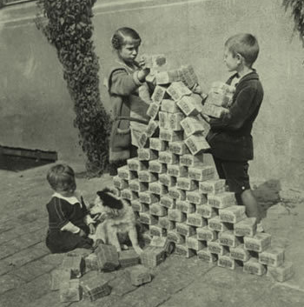
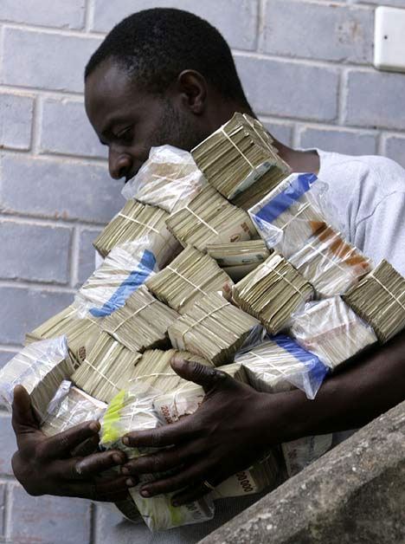
Hyperinflation

Slide 4
Germany and Hyperinflation (P = 100 in 1913)
Date | Value of Price Index
Jan 1921 | 1400
Jan 1922 | 3700
Jan 1923 | 278,500
Aug 1923 | 94,400,000
Sept 1923 (state of emergency declared) | 2,390,000,000
Oct 1923 (failed Nazi coup 11/9/23) | 709,600,000,000
Nov 15, 1923 (converted to new denomination) | 75,000,000,000,000

Slide 5
Anticipated Inflation
Anticipated: Expected; consumers and businesses plan for it

Slide 6
Indexes
CPI= Consumer Price Index
Based on basket of goods from 1983 (between ‘82-’83)
GDP Deflator
Based on general price index
= current basket of goods current price/current basket of goods at real price X 100
PPI= Producer Price Index
Based on change in selling prices received by producers

Slide 7
Indexes continued
PCE= Personal Consumption Expenditure
Based on Consumer piece of the GDP

Slide 8
Unexpected Inflation Causes: Push
Causes are up for debate
Cost-Push:
Wages are exceeding productivity
Administered Prices
Market Structure
Invisible Handshake
3rd Party Payment Systems
Trade Restrictions

Slide 9
Unexpected Inflation Causes: Pull
Demand-Pull:
Government Deficit Spending
Transfer Payments
Automatic Stabilizers
Politics

Slide 11
Unanticipated Winners
High Incomes
Debtors
Hard assets
Exporters

Slide 12
Unanticipated Losers
Fixed incomes
Creditors
Importers
Consumers
“shoe leather costs”
Producers
Wealth Management

Slide 14
Sample problems: calculate Real Interest Rate
End of Year | CPI | Nominal Interest Rate | Real Interest Rate
1 | 100
2 | 110 | 15%
3 | 120 | 13%
4 | 115 | 8%

Slide 15
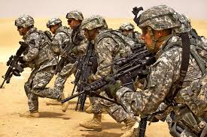
Labor and Unemployment
Working Age Population
Labor Force
Labor Force Participation Rate: Labor Force/Working Age Pop X 100
Employment-Population Ratio = Total Employed/Total Population

Slide 16
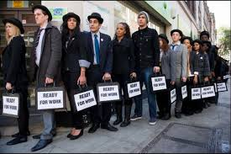
Unemployment
Unemployment Rate = unemployed/labor force population X 100
Who is considered “Unemployed”

Slide 17
Unemployment continued
Not in labor force if…

Slide 18
Types of unemployment
Frictional: choice, not a “fit”
Structural: change in firm/tech/marketing
Cyclical: business cycle changes
Seasonal:

Slide 19
Who is not counted as “unemployed”?
Discouraged
Marginally attached

Slide 20
Other problems with unemployment measurements
Dishonest workers
Involuntary part-time workers
Source: BLS

Slide 21
* Source: BLS

Slide 22
Costs of unemployment: Economic
Economic:
Opportunity cost
Okun’s Law
For every 1% increase in unemployment = 2-3% decrease in output

Slide 23
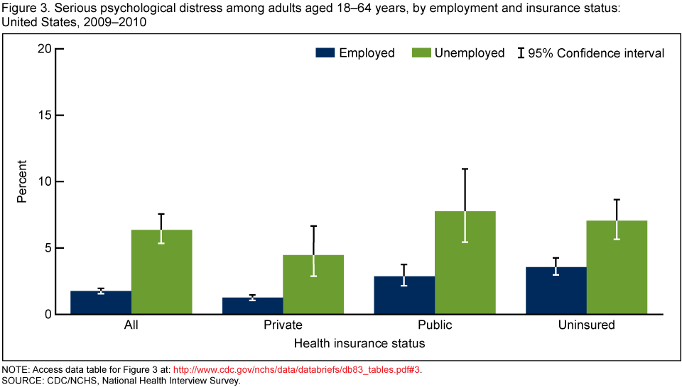
Costs of Unemployment: beyond monetary
Broader impact:
Psychological and physical impacts
Discrimination

Slide 24
Unemployment disparity
 | August 2007 (full employment) | August 2011 (severe slump)
Overall | 4.6% | 9.1%
Whites | 4.2 | 8.0
Hispanics | 5.5 | 11.3
Blacks | 7.7 | 16.7

Slide 25
Sample problem: Freedonia uses the same method to calculate unemployment as the BLS. Compute their unemployment rate below.
Population | 60,000
Under 16 | 9000
Over 16
In military service | 600
In hospitals | 60
In prison | 200
Worked 1 hr or more in previous week | 46,000
Searched for work in previous 4 weeks | 2140
Did not work in previous week, but would like a job if offered | 200

Slide 26
Freedonia problems continued
A. How large is Freedonia’s labor force?
B. How many discouraged workers live in Freedonia?
C. How are missing citizens (not all are accounted for in the chart) classified? What might they be doing?
D. How many of Freedonia’s citizens are not in the labor force?

Slide 27
What is full-employment?
Natural rate of unemployment is about 5% in the U.S. in a normally functioning economy
Frictional + structural unemployment/labor force X 100 = natural rate of employment
Full employment is ≠ 100%
Level of employment corresponds with natural rate
Excludes cyclical unemployment

Slide 28
Some is okay
Some unemployment is alright
Frictional unemployment: moving to better jobs; better “fits”

Slide 29
Calculate Wages with inflation
Real Wage = Nominal Wage in that Year/CPI in that year X 100
Real earnings in 1980: $269/week / CPI of 86.3 X 100 = $312
Real earnings in 2010: $751/week/ CPI of 219.2 X 100 = $343

Slide 30
Practice with wages
Year | Nominal weekly Earnings | CPI | Real Earnings (1983 $)
1980 | $269 | 86.3 | $312
1985 | $348 | 109.3 | $318
1990 | $417 | 133.8 | $312
1995 | $482 | 153.5 | $314
2000 | $581 | 174.0 | $334
2005 | $658 | 196.8 | $334
2010 | $751 | 219.2 | $343

Slide 31
Calculate Inflation and Real Hourly Wage Rate
Year | CPI | Inflation Rate (nom CPI – real CPI/real CPI) | Nominal Wage | Real Wage (nom wage/CPI)
1 | 100 |  | $10.00
2 | 110 |  | $12.00
3 | 120 |  | $13.00
4 | 115 |  | $12.75

Slide 32
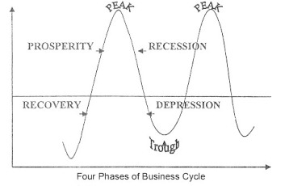
How does this all fit together? The business Cycle: Times of Prosperity

Slide 33
During Recession (2 consecutive quarters of declining GDP)

Slide 34
During Depression (depends on source – 4 – 8 quarters of declining GDP)
47 Recessions and Depressions in U.S. History:
Panic of 1785
Mid 1800s
Panic of 1857
1873
1893
Depression of 1907
Depression of 1920-1
Great Depression 1929

Slide 35
During Recovery

Slide 36
Kondratieff Wave
Theory of Cycle of business cycles: pattern of 50-60 yrs
Cycle of prosperity preceded by population increases (includes immigration)
Leads to high demand
Producers can’t keep up with demands
High inflation
High credit use
Each cycle grows better with higher and higher inflation
Inflation devalues the dollar
Government is overturned
Downward part of cycle
Poverty and depression

Slide 37
1945
1929

Slide 39
Theories for Business Cycle
Over-production theory
Under-Consumption theory
Monetary theory
Imbalance between saving and investment

Slide 40
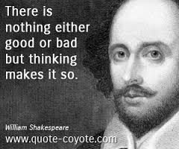
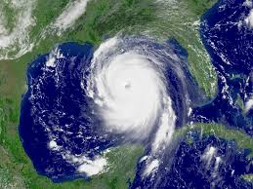
More theories on the business cycle
Psychological Theory
War Theory
Sunspot, Weather, Crop Theories
Innovation Theory
Self-Generating Theory

