Slide 1
WARM UP:
There’s a flood and scientists discover that soy will immunize people from Ebola – all in the same year. Wisconsin produces soybeans and has a lot of hypochondriacs. What happens to the equilibrium price and quantity of soybeans in Wisconsin?
The new equilibrium price of soybeans is $10/bushel for 1000 bushels. The government implements a ceiling of $9. What happens to the amount of bushels produced? What about the demand for immunizations?
The farmers march on the Capital and the ceiling is changed to a floor of $11. Now what happens to the equilibrium?

Slide 2
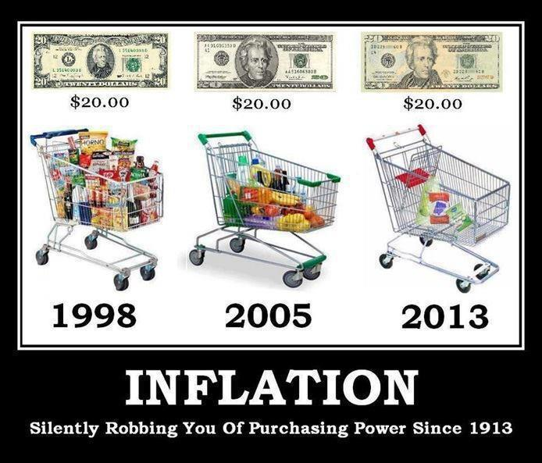
INFLATION
Purchasing Power

Slide 3
Who cares?
- Redistributes purchasing power:
Inflation Consumer Seller
Buying power Profits
*Reduces Purchasing Power if the rate doesn’t match nominal wages
*Spend more time and resources shopping
*Costs to producers

Slide 4
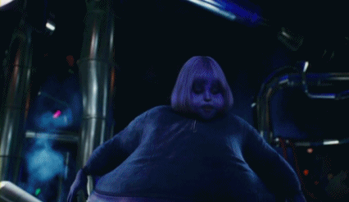
Definitions:
Inflation: Prices are moving up
Deflation: Prices are moving down
Stagflation: high unemployment and high inflation
https://www.khanacademy.org/economics-finance-domain/core-finance/inflation-tutorial

Slide 5
Feeling the Power… to purchase goods
What I pay today may not be what I’ll pay for the same thing next year.
Nominal vs. Real values
Current price vs. adjusted for time

Slide 6
1957: $11,000
2014: $107,000

Slide 7
How do you figure this out?
Price index = Basket of goods today/basket of goods in base year X 100
Q stays the same even though buying behavior changes
Sum (base yr Q)(current yr P)/ Sum of (base yr Q) (base yr P)
INFLATION = % change = CPI today – CPI base yr/CPI base
BLS determines what is in the CPI

Slide 8
CPI is the “Basket of Goods”

Slide 9
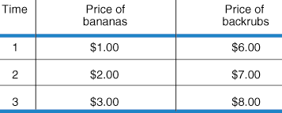
Consumers in Country B only purchase bananas and backrubs
1st -fix the basket of goods. Typical consumer in Country B buys 5 bananas & 2 backrubs in a given period of time, so fixed basket is 5 bananas and 2 backrubs.
2nd - find prices of these items for each time period. Data is in the table
3rd - compute the basket's cost for each time period.
In time period 1 the fixed basket costs (5 X $1) + (2 X $6) = $17
In time period 2 the fixed basket costs (5 X $2) + (2 X $7) = $24
In time period 3 the fixed basket costs (5 X $3) + (2 X $8) = $31
4th - choose a base year and to compute the CPI.
Any year can serve as base year, let's choose time period 1. The CPI for time
period 1 is ($17 / $17) X 100 = 100.
period 2 is ($24 / $17) X 100 = 141.
period 3 is ($31 / $17) X 100 = 182.
Since the price of the goods and services that comprise the fixed basket increased from time period 1 to time period 3, the CPI also increased. This shows that the cost of living increased across this time period.

Slide 10
But I thought that…
Anticipated inflation
Unanticipated inflation
No inflation means that your money today will buy the same amount tomorrow.

Slide 11
Interest rates and Inflation
Nominal vs. Real
Rate of $ today vs. Rate of $ today less the anticipated rate of inflation
Real interest rates are the rate of return in terms of purchasing power
Interest is a way to bank against inflation –
Loan for $100 today that takes 1 year to pay back
Is the $100 going to buy as much today as it does in 12 months?

Slide 12
Sample problem
Suppose the nominal interest rate is 7%
Expected rate if inflation is 5%
Current year is the base year for the price index used to calculate inflation
What is the real interest rate?
Nominal rate – inflation rate = real rate
7% – 5% = 2%

Slide 13
More problems
Real interest rate is 3%
Nominal rate is 6%
What’s the inflation (anticipated) rate?
Nominal – Real = Inflation (anticipated) rate
6% - 3% = 3%

Slide 14
GDP Growth Rate =
[$\left(Real GDP current year −Real GDP previous year\right)÷Real GDP previous year] X 100$
[(Real Yc – Real Yp)/ Real Yp] x 100 = GDP Growth Rate

Slide 15
Ennisland’s people only purchase candy and chips. In 2012, they spent $15 on candy, at $1 each. They spent $150 on chips, at $2 each, the same year. In 2013, candy cost $1.25/ea and chips cost $3/ea.
What was the CPI in 2012 for candy and chips?
What was portion of the household budget was spent on chips?
What was the CPI in 2013?
What was the rate of inflation?

