Slide 1
The Business Cycle:
GDP

Slide 2
What is GDP?
How do we measure economic growth as a country?
Standard of Living – the level of consumption of goods and services. GDP is a way to compare standards of living between countries.

Slide 3
Circular Flow

Slide 4
Business Cycle
Peak
Expansion
Recession
Depression

Slide 5
GDP and the business cycle
Fluctuates around the cycle
How we determine which cycle we are in
Recession: 2 quarters
Depression: 2 years
Expansion:
Peak:

Slide 6
Calculating GDP
Expenditure approach:
GDP=C+I+G+X
Income approach:
GDI= wages + interest + rent + profits

Slide 7
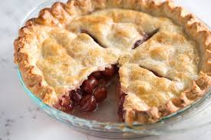
What are the pieces of the GDP pie?
Final versus Intermediate Goods

Slide 8
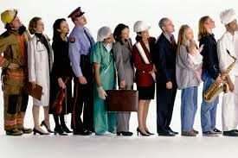
continued
Value added
Markets-
Product
Factor

Slide 9
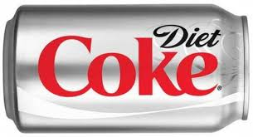
Another piece of pie?
Consumer expenditures
1
2
3

Slide 10
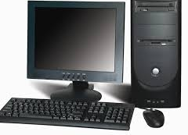
Mmm… Pie…
Investment (think business spending vs. consumer)
Capital goods
Inventory investment
Government expenditures

Slide 11
Example of Production that can be included
Stage of Production |  | Dollar Value of Sales | Value Added
1 | Producing Oil | 1.50 | 1.50
2 | Transporting Oil | 2.00 | .50
3 | Refining oil into gasoline | 2.55 | .55
4 | Wholesale gasoline distribution | 3.10 | .55
5 | Retailing the gasoline | 3.50 | .40
Total | Dollar Value of All Final Sales | 12.65 | 3.50
Stages of production for a gallon of gasoline:

Slide 12
The last piece of pie?
Net Exports
Imports: coming in (buying)
Exports: going out (selling)
X=total exports – total imports

Slide 13
Gross…
Gross domestic product
Without deductions
Deductions = depreciation (Capital Consumption Allowance)
NDP (Net Domestic Product)= GDP-depreciation
NDP= C+(I- depreciation)+G+X

Slide 14
Income Approach
Wages – income of all types (including SS contributions)
Interest – net sum
Paid to households (received-paid)
Paid by foreign residents
Rent
Profits

Slide 15
Non-income
Indirect Business Taxes – paid by consumers (government is receiving)
Depreciation – ADD in

Slide 16
GDP = GDI

Slide 17
Problems with GDP
Nonmarket production
Issues with comparing countries
Well-being?
Financial transactions
Transfers
Purchasing power and exchange rates

Slide 18
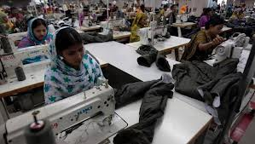
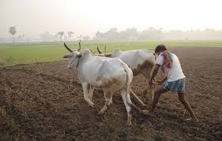

Slide 19
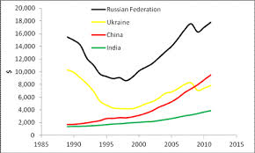

Slide 20
HDI: United Nations Calculation based on life expectancy, education attained and expected to attain, and income

Slide 21
HSDI: Human Sustainable Development Index (2010)

Slide 22
GNP
What is GNP?
What are included in the GNP?
What’s wrong with it?

Slide 23
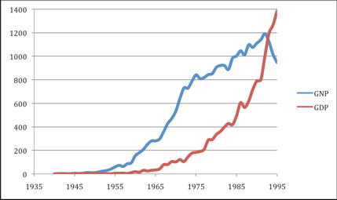

Slide 24
What’s “real”?
Real vs. Nominal Value
Nominal = market price at current value
Real = adjusted for time between years
Constant dollars
Real Per Capita=
Real GDP/population
Used to compare standards of living between countries

Slide 25
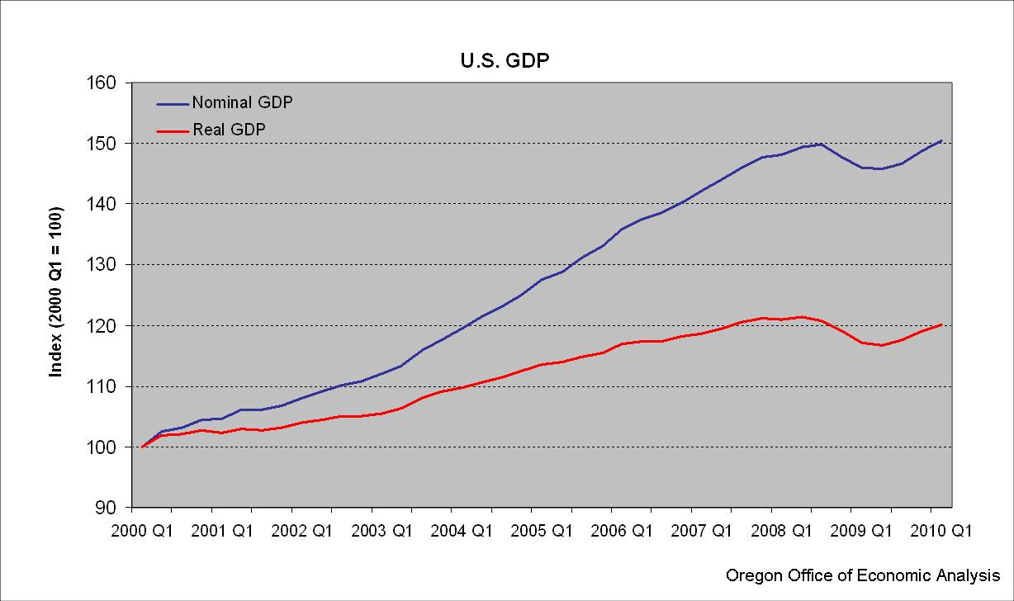

Slide 26
National Accounting
Other parts of:
National Income (NI) = NDP – indirect business taxes
Personal Income (PI) = income before income taxes
Disposable Personal Income (DPI) = income after income taxes

Slide 27
Many other ways to measure a country’s economic temperature
Inflation
Unemployment levels

