Slide 1
Economic Schools
Overview

Slide 2
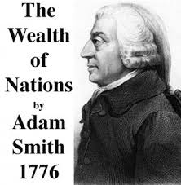
Classical : Free Market
1776 Adam Smith’s Wealth of Nations
“invisible hand”
Free markets regulate themselves without government intervention in production, trade or resource allocation
Prices are determined by levels of output, technology and wages
David Ricardo
Thomas Malthus
John Stuart Mill

Slide 3
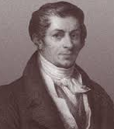
Say’s Law
Jean Baptiste Say (1767 – 1832)
“A product is no sooner created, than it, from that instant, affords a market for other products to the full extent of its own value.”
“As each of us can only purchase the productions of others with his own productions – as the value we can buy is equal to the value we can produce, the more men can produce, the more they will purchase.”

Slide 4
Marxism
Karl Marx (1818 – 1883)
Socialism
Capitalism would eventually destroy itself
Based on class system
Struggle, instability
Profit is ill got by exploitation of the proletariat which will lead to revolution
Evolution: feudalism to capitalism to socialism

Slide 5
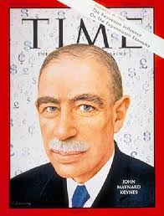
Keynesian Economics
John Maynard Keynes (1893 – 1946)
Government intervention (policy) to manage economy and encourage growth
Goal to manage business cycle
Aggregate demand as strongest indicator of economic cycles (especially inflation and depressions)
Popular during Depression
Spend to get out of economic down-turn

Slide 6
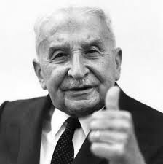
Austrian School: Classical Liberalism
Ludwig Von Mises (1881 – 1973)
Idea of marginal utility: gain from an increase, or loss from a decrease, in the consumption of that good or service (satisfaction derived by consuming one thing over another)
No government intervention because monitoring the economy is too much for a government to handle (why socialism will fail)

Slide 7
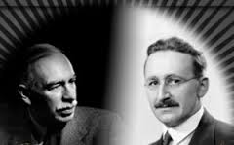
Friedrich Hayek (1899 – 1992)
Monetary approach
Business cycles are result of central banks creating inflation through credit expansion which leads to capital misallocation through manipulated low rates
Instability results because money supplies should be left to self regulate
Price mechanism will adjust itself to consumer demands leading to market equalizing itself
Keynes and Hayek

Slide 8
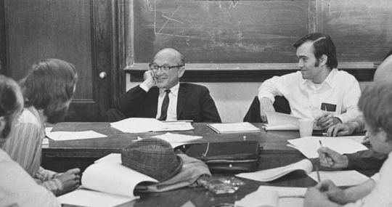
University of Chicago School
Monetarists
Supply of money in the economy determines economic growth or deflation
Money supply vs. Demand controls economy
Milton Friedman (1912 – 2006)
Minimal government except in regulating money supply
Anti government spending to spur economy
Inflation caused by increase in money supply
Free market

Slide 9
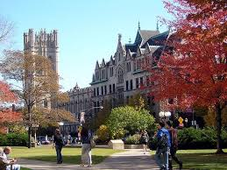
University of Chicago School continued
Robert Lucas (1937 - )
Applied micro analysis to study macro economy
Cause and effect determination of indicators: employment, inflation, government policies, and role of monetary policy
Gary Becker (1930 – 2014)
Sociological perspective
Examined the role of human capital
Family structure
Utility

Slide 10
Neo Keynesian
Hybrid of Chicago School and Keynes
Combination of monetary policy
Imperfect competition exists = market can’t work everything out untouched

Slide 11
Supply Side Economics
Lower barriers/regulations
Make easier for firms to supply goods
Consumers benefit because supply will drive down price
Expanding businesses will need employees
Demand is a result of supply vs. Keynesian demand drives supply
2nd meaning - tax cuts thought to increase revenues (Voodoo or Reaganomics) – we’ll get to this in fiscal policy and taxation

