Slide 1
Economic Growth

Slide 2
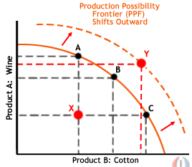
What is Economic Growth?
An outward shift in the PPC:
“The increase in economic productivity of a country.”

Slide 3
Real GDP Per Capita
- Need to measure more than just output or Real GDP without adjustments
Adjusts for population growth
Measured by rate of change in per capita real GDP/year

Slide 4
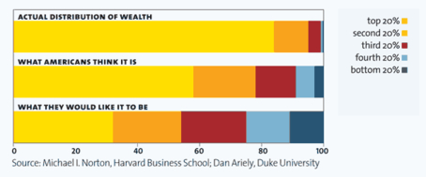
Issues with per capita measurements
Distribution:
Averaged (problem with outliers)
Doesn’t reflect the poor staying poor
Who benefited from the growth?

Slide 5
Is the Real Standard of Living changed with growth?
Not necessarily
Work hours = Leisure time
i.e. per capita Real GDP in U.S. stays at $50,000 for 10 yr
Work hours go from 40 to 36 hrs/wk

Slide 6
Benefits of Growth? Duh.
- illiteracy - health
- poverty - life expectancy
- political stability

Slide 7
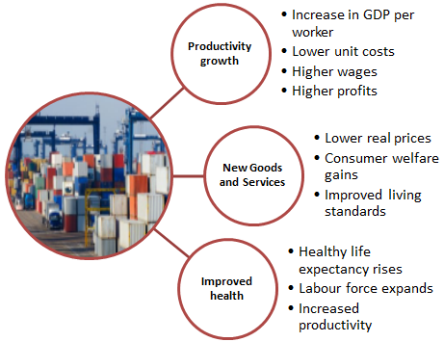

Slide 8
Is all economic growth good?
Psychological effects:
Increased growth = increased perceived needs
Higher expectations = higher potential disappointments
Ignores cultural impacts
Environmental destruction
Erosion of family structure
Congestion/Crowding

Slide 9
Why do we care?
Year to year change is not significant
Compounds: Adds up
Year | $ Amount | Interest Rate | $ Amount Change | Year End $ Amount
1 | $10 | 5% | $0.50 | $10.50
2 | $10.50 | 5% | $0.53 | $11.03
3 | $11.03 | 5% | $0.55 | $11.58

Slide 10
Rule of 70
How long it will take a country to double their per capita Real GDP
70 / average rate of growth
i.e. if the average rate of growth is 10%
70/10 = 7 years for per capita Real GDP to double

Slide 11
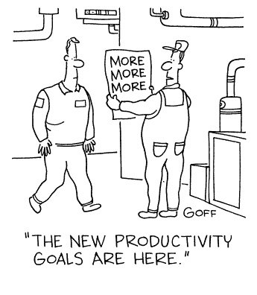
Labor Productivity
Total Real Domestic Output or GDP divided by # of workers
OR
GDP # / of labor hours
- Increases when the average output per worker or hours worked during a specific time period increase

Slide 12
GDP GROWTH
3 Main Contributors:
1. rate of growth of capital (including human)
2. rate of growth of labor (# of workers and hours)
3. rate of capital and labor production

Slide 13
Economic Growth = per capita growth rate of capital and labor + per capita growth rate of their productivity
New Growth Theory: States that technology is a separate factor of production; we need to understand what drives it

Slide 14
Innovation
Research and Development-
Inventions lead to innovation
More rewards = more technological advances
How to measure: patent records (good for 20 years)
Positive externalities result
i.e. developing countries can “skip” the time and resources needed to develop technology
i.e. others can improve upon the technology
More innovation = lower production costs & new goods and services

Slide 15
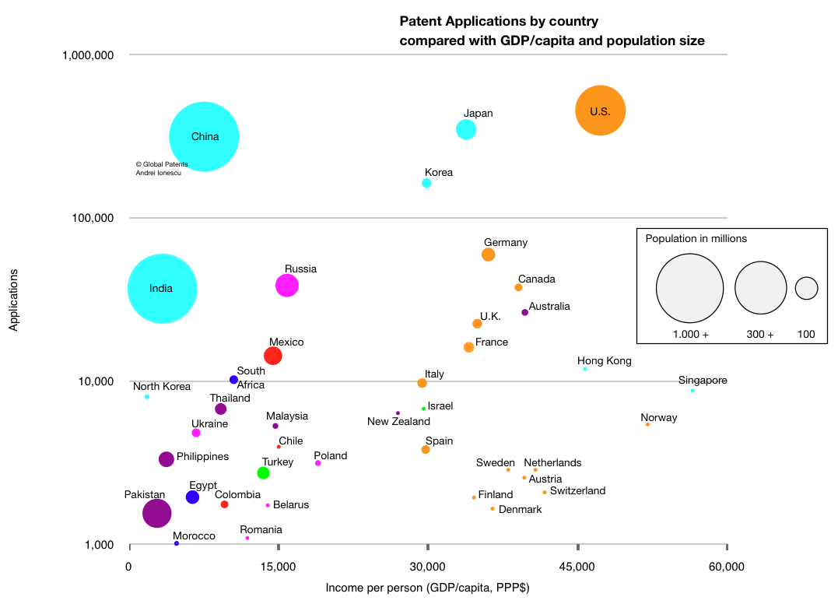

Slide 16
Human Capital
Innovation/Technology/Labor = Economic Growth
Quality Labor Innovation
More productivity = more growth
Examples: skills, education

Slide 17
Keys to a nation’s economic development
Natural Resources = is a strong determinant, but is limited today ability to produce goods
4 main factors:
System of Property Rights – if people feel confident in the security of their private property rights, they are more willing to invest, save and consume
Educated Population – increased innovation, increased productivity

Slide 18
3. “Creative Destruction” – in order for new businesses to develop forming new jobs and growth, the old firms have to be destroyed to make room, but it costs time and money
Poor countries can’t or won’t implement new technology and methods resulting in lagging productivity
4. Limit protectionism – open economies that encourage open trade are exposed to more innovation, driven to discover new ways to specialize and compete

Slide 19
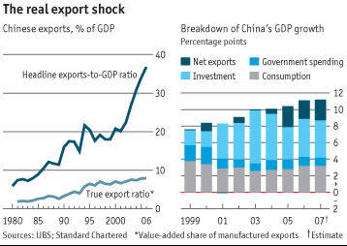

Slide 20
Role of Savings
Consume less today so you can consume more in the future
Rate of Savings:
Means
Standard of Living:
Need savings for
Investments in capital to grow

Slide 21
Aggregate Supply and Demand
Khan Academy AD AS

