Slide 1
Aggregate Demand and Supply

Slide 2
Aggregate Demand (AD)

Slide 3
Aggregate Demand
The sum of all expenditure in the economy over a period of time
Macro concept – WHOLE economy
Formula:
AD = C+I+G+NX
C= Consumption Spending
I = Investment Spending
G = Government Spending
NX = difference between spending on imports and receipts from exports (Balance of Payments)

Slide 4
Aggregate Demand Curve
Why does it slope down from left to right?
Assume the Federal Reserve sets short term interest rates
Assume a rise in the price level will be met by a rise in interest rates
Any increase in interest rates will raise the cost of borrowing:
Consumption spending will fall
Investment will fall
International competitiveness will decrease – exports fall, imports rise
Therefore – a rise in the price level leads to lower levels of aggregate demand

Slide 5
Price Level Goes Up
Real Balance Effect = Price level goes up; real value of money goes down; spending goes down
Interest Rate Effect = Prices go up; inflation goes up; consume less durable goods; businesses spend less on capital; AD goes down
Open Economy Effect = Substitution of foreign goods when the US price level goes up; US goods are more expensive compared to foreign goods; buy less US goods; demand for exports down

Slide 6
Price Level Goes Down
Price level down:
Value of goods goes up
Spending goes up
Rates go down
Investments go up
Exports go up

Slide 7
Aggregate Demand Curve
Price Level
120
100
AD
Y2
Y1
Real National Income
U = 7%
U = 5%

Slide 8
Aggregate Demand Shifts
Price Level
100
AD2
AD
Y1
Y2
Real National Income
U = 5%
U = 2%

Slide 9
Consumption Expenditure
Exogenous factors affecting consumption:
Tax rates
Incomes – short term and expected income over lifetime
Wage increases
Credit
Interest rates
Wealth
Property
Shares
Savings
Bonds

Slide 10
Investment Expenditure
Spending on:
Machinery
Equipment
Buildings
Infrastructure
Influenced by:
Expected rates of return
Interest rates
Expectations of future sales
Expectations of future inflation rates

Slide 11
Government Spending
Defense
Health
Social Welfare
Education
Foreign Aid
Regions
Industry
Law and Order

Slide 12
Import Spending (negative)
Goods and services bought from abroad – represents an outflow of funds from the US (reduces AD)

Slide 13
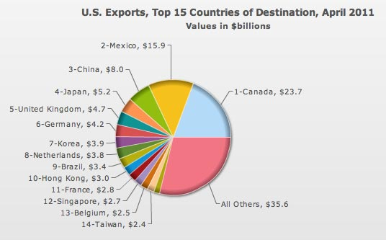
Export Earnings (Positive)
Goods and services sold abroad – represents a flow of funds into the US (raises AD)

Slide 14
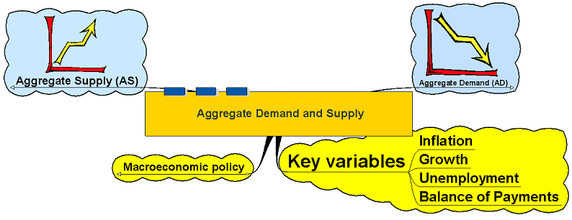
Key Variables

Slide 15
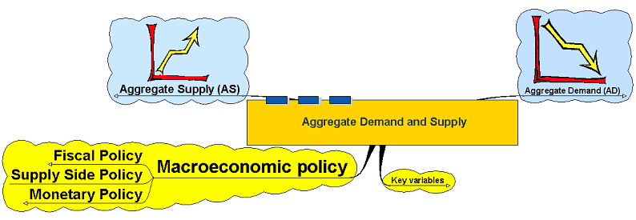
Macroeconomic Policy

Slide 16
Fiscal Policy
Government Income (taxes and borrowing)
Government Spending

Slide 17
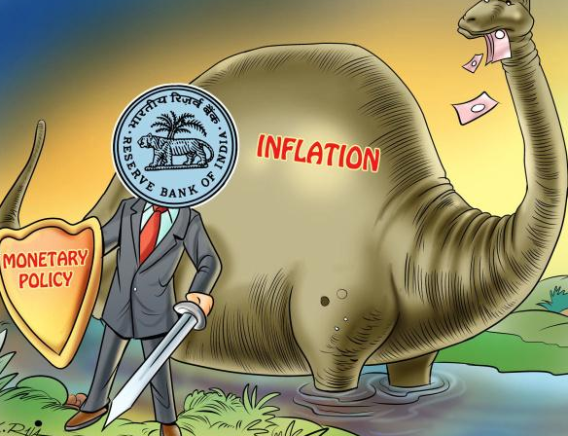
Monetary Policy
Interest Rates (US Federal Reserve)
Money supply

Slide 18
Aggregate Supply (AS)

Slide 19
AS= Capacity of the Economy
Costs of Production
Technology
Education and Training
Incentives
Taxes
Capital Stock
Productivity
Labor Market

Slide 20
Aggregate Supply
Price Level
AS
Real National Income

Slide 21
Aggregate Supply: Classical LRAS
Price Level
LRAS
Yf
Real National Income

Slide 22
Aggregate Supply Curve: Keynes LRAS
Price Level
AS
Economy starts to overheat
Y1
Yf
Real National Income

Slide 23
Aggregate Supply – can result from Supply Side Shocks
Price Level
AS1
AS2
Yf1
Yf2
Real National Income

Slide 24
Moving from SRAS to LRAS
When capital increases, the aggregate supply curve will shift to the right, prices will drop, and the quantity of the good or service will increase.
The short-run aggregate supply curve is an upward slope. The short-run is when all production occurs in real time.
The long-run curve is perfectly vertical, which reflects economists' belief that changes in aggregate demand only temporarily change an economy's total output. The long-run is a planning and implementation stage.
Aggregate supply moves from short-run to long-run by considering some equilibrium that is the same for both short and long-run when analyzing supply and demand. That state of equilibrium is then compared to the new short-run and long-run equilibrium state from a change that disturbs equilibrium.

Slide 25
Aggregate Supply: SRAS
Price Level
SRAS 1
SRAS
SRAS 2
Real National Income

Slide 26
Putting AD and AS together
AS
Price Level
105
100
AD 1
AD
Y1
Y2
Yf
Real National Income

Slide 27
Putting AD and AS together
Further increases in AD would lead to successively smaller increases in growth and employment at the cost of ever higher inflation.
AS
Price Level
115
AD2
105
100
AD1
AD
Y1
Y2
Yf
Real National Income
Y3

Slide 28
Sustained Growth
Sustained growth (not to be confused with sustainable economic growth) occurs when AS and AD rise at similar rates – national income can rise without effects on inflation
Price Level
AS
AS1
100
AD2
AD
Y1
Y2
Real National Income

Slide 29
Long Run Equilibrium
Intersection of AD and LRAS
Secular Deflation: unchanged AD curve for 10 yrs
Results in outward shift of LRAS = deflation
US 1872 and 1895 – price level fell
Increase in AD

Slide 30
Causes of Inflation
Supply-side? Not cause for persistent inflation. Short term if AS goes down at a given point of AD
Demand-side – rightward shift in AD faster than rightward AS = persistent inflation

Slide 31
Classical Model
1770s: questions arose of how society could reorganize itself so an individual can make his own wealth
Goal of country growing output
Smith’s Wealth of Nations
System to explain price levels:
National levels of output, income, employment, consumption, savings and investment
David Hume (1711 – 1776) – man’s motivations are based on desire, not reason.
According to Hume, in the short-run, and increase in the money supply will lead to an increase in production.
According to Hume, in the long-run, an increase in the money supply will do nothing.

Slide 32
Say’s Law
Supply creates its own demand
People only produce more if they want to trade the extra for other goods

Slide 33
4 Assumptions of the classical model
Pure competition exists:
No single buyer or seller can affect a price
Wages and prices are flexible
Supply and demand dictates
People are motivated by self-interest
Firms want to maximize profits
Households want to maximize their well-being
People can’t be fooled by money prices
Buyers and sellers react to RELATIVE prices not to changes in money value when relative prices remain unchanged
Prices and wages go up = buy same amount with changed income

Slide 34
Classical: Equilibrium in Credit Market
Each $ saved equals $ invested in business
Interest rate equates amount of credit demanded with the amount of credit supplied
Planned investment = planned saving
Saving is the supply of credit
Investment is the demand for credit

Slide 35
Classical: Equilibrium in the Labor Market
- Excess labor at a certain wage level = wage level is too high
- Unemployed will be employed if accept lower wages
- only frictional and structural unemployment exists
- Level of employment determines (all else constant) real GDP

Slide 36
Classical Model continued
Long-term involuntary unemployment not possible
Say’s law and flexible rates, prices, wages keep full employment
Results in LRAS as vertical line
Full employment is amount produced in economy with:
Full information
Full adjustment of wages
Full adjustment of prices
Increase in AD:
Increase in price level as wages rise due to rise in demand for labor
Real GDP is unchanged on LRAS curve
Decrease in AD:
Decrease in price level as wages fall due to decrease in demand for labor
Workers bid down wages in response to unemployment
Other inputs fall
Real GDP is unchanged on LRAS curve

Slide 37
Keynesian Theory
Keynes: The General Theory of Employment, Interest, and Money (1936)
Aggregate demand is influenced by a series of factors and responds unexpectedly. Shifts in aggregate demand impact production, employment, and inflation in the economy
During a recession the economy may not return naturally to full employment. The government must step in and utilize government spending to stimulate economic growth .A lack of investment in goods and services causes the economy to operate below its potential output and growth rate.
Overcoming an economic depression required economic stimulus, which could be achieved by cutting interest rates and increasing the level of government investment

Slide 38
Keynes and unemployment
Unemployment is the result of structural inadequacies within the economic system. It is not a product of laziness as believed previously.
Unions and long–term employment contracts explain downward inflexibility of nominal wages
Lead to “stickiness” of wages and involuntary unemployment
Even in a situation with excess capacity and high unemployment, prices may not fall

Slide 39
What is the typical shape of a short-run aggregate supply curve?
A) Upward sloping
B) Downward sloping
C) Vertical
D) Horizontal

Slide 40
What is the typical shape of a short-run aggregate supply curve?
A) Upward sloping
B) Downward sloping
C) Vertical
D) Horizontal

Slide 41
What factors are fixed in the short run?
A) Prices, wages, capital, and labor
B) Prices, wages, and capital
C) Prices and wages
D) Capital and labor

Slide 42
What factors are fixed in the short run?
A) Prices, wages, capital, and labor
B) Prices, wages, and capital
C) Prices and wages
D) Capital and labor

Slide 43
Which of the following explains why the long run aggregate supply curve must be vertical?
A) Long run analysis assumes all inputs are used optimally, which implies one level of efficient output
B) Long run analysis assumes wages and prices are fixes, which implies one level of efficient output
C) In the long run, firms have already made their decisions about optimal production and do not vary
D) In the long run, the factors that affect the production function do not influence GDP growth

Slide 44
Which of the following explains why the long run aggregate supply curve must be vertical?
A) Long run analysis assumes all inputs are used optimally, which implies one level of efficient output
B) Long run analysis assumes wages and prices are fixes, which implies one level of efficient output
C) In the long run, firms have already made their decisions about optimal production and do not vary
D) In the long run, the factors that affect the production function do not influence GDP growth

Slide 45
Which of the following is a real-world interpretation of the vertical long run aggregate supply curve?
A) In the long run, GDP will respond to changes in the price level but not changes in inputs
B) The long-run level of potential GDP is not affected by changes in demand or prices
C) In the long run, GDP will grow at a constant, unchanging rate
D) All of these answers

Slide 46
Which of the following is a real-world interpretation of the vertical long run aggregate supply curve?
A) In the long run, GDP will respond to changes in the price level but not changes in inputs
B) The long-run level of potential GDP is not affected by changes in demand or prices
C) In the long run, GDP will grow at a constant, unchanging rate
D) All of these answers

Slide 47
What does the model of long run aggregate supply assume about labor?
A) The labor market is always in equilibrium and the entire population is employed
B) Wages are sticky but no minimum wage regulations exist
C) Wages are sticky and minimum wage regulations exist
D) The labor market is always in equilibrium and everyone in the workforce is employed

Slide 48
What does the model of long run aggregate supply assume about labor?
A) The labor market is always in equilibrium and the entire population is employed
B) Wages are sticky but no minimum wage regulations exist
C) Wages are sticky and minimum wage regulations exist
D) The labor market is always in equilibrium and everyone in the workforce is employed

Slide 49
Which of the following changes in the labor market will shift the long run aggregate supply curve?
A) A change in the number of available workers or wage rate
B) A change in the number of labor hours or wage rate
C) A change in the labor market from full employment to less-than-full employment
D) A change in the number of available workers or labor hours

Slide 50
Which of the following changes in the labor market will shift the long run aggregate supply curve?
A) A change in the number of available workers or wage rate
B) A change in the number of labor hours or wage rate
C) A change in the labor market from full employment to less-than-full employment
D) A change in the number of available workers or labor hours

Slide 51
What is one reason the government may invest in technological progress that will be shared freely, producing no profit?
A) An improvement in technology shifts supply to the left, increasing GDP
B) An improvement in technology shifts supply to the right, increasing GDP
C) Technological progress leads to higher employment and prices
D) Technological progress leads to lower employment and prices

Slide 52
What is one reason the government may invest in technological progress that will be shared freely, producing no profit?
A) An improvement in technology shifts supply to the left, increasing GDP
B) An improvement in technology shifts supply to the right, increasing GDP
C) Technological progress leads to higher employment and prices
D) Technological progress leads to lower employment and prices

Slide 53
What will happen if available capital increases?
A) The supply curve will shift to the right, prices will rise, and quantity will fall
B) The supply curve will shift to the right, prices will drop, and quantity will increase
C) The supply curve will shift to the left, prices will drop, and quantity will increase
D) The supply curve will shift to the left, prices will rise, and quantity will fall

Slide 54
What will happen if available capital increases?
A) The supply curve will shift to the right, prices will rise, and quantity will fall
B) The supply curve will shift to the right, prices will drop, and quantity will increase
C) The supply curve will shift to the left, prices will drop, and quantity will increase
D) The supply curve will shift to the left, prices will rise, and quantity will fall

Slide 55
Which of the following factors does NOT cause the short-run aggregate supply curve to shift?
A) Changes in quality of labor
B) Quantity that stays the same
C) Taxes and subsides
D) Prices of raw materials

Slide 56
Which of the following factors does NOT cause the short-run aggregate supply curve to shift?
A) Changes in quality of labor
B) Quantity that stays the same
C) Taxes and subsides
D) Prices of raw materials

